Slide 1
Predicting Students’ Performance
Identifying the best model for predicting low performance students based on lifestyle factors
Natália Bernardo

Slide 2
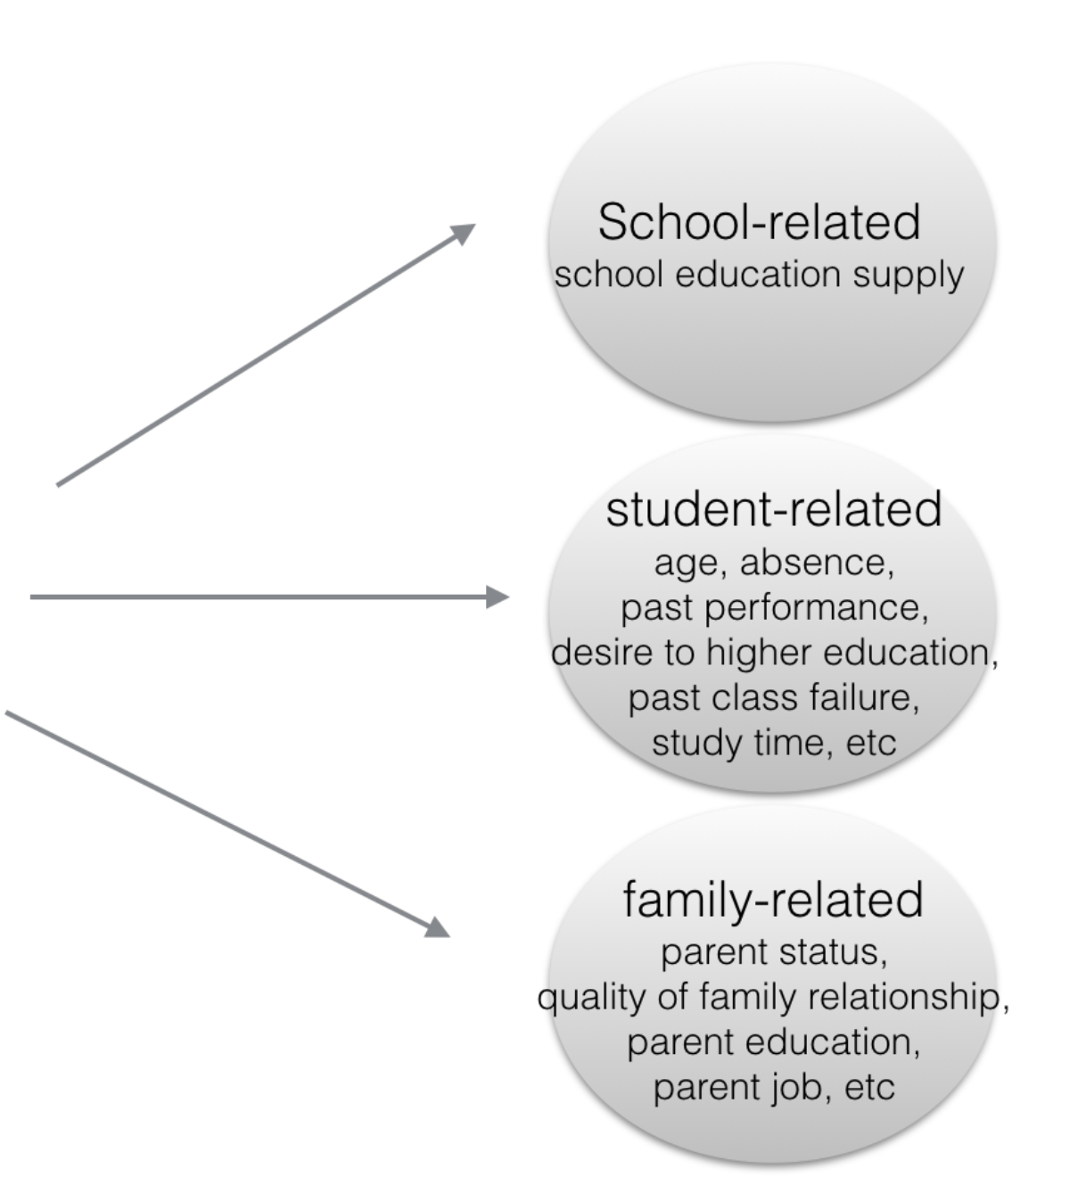
Predicting students’ performance based on lifestyle factors
649 observations
33 variables
Data: Student Performance Data Set from two schools in Portugal (UCI Machine Learning)
Motivation: Students’ failures in Portugal is the highest in Europe
Goal: Predict students who may fail to provide advanced help for them before the exam

Slide 3
Target Variable (Pass = 0 / Fail = 1)
Fail
(15% of students)
Pass
(85% of students)

Slide 4
Features Transformation
Binary Categorical Features
Multi-categorical Features
Continuous Numeric Features
School
Gender
Address Type
Family size
Parent's cohabitation status
Extra educational support
Family educational support
Extra paid classes
Extra-curricular activities
Attended nursery school
Internet access at home
In a romantic relationship
School extra educational support
Father’s/mother's education
Father’s/mother’s job
Reason to choose the school
Guardian
Travel time
Study time
Past class failures
Quality of family relationships
Free time after school
Going out with friends
Workday/ weekend alcohol consumption
Current health status
Number of school absences

Slide 5
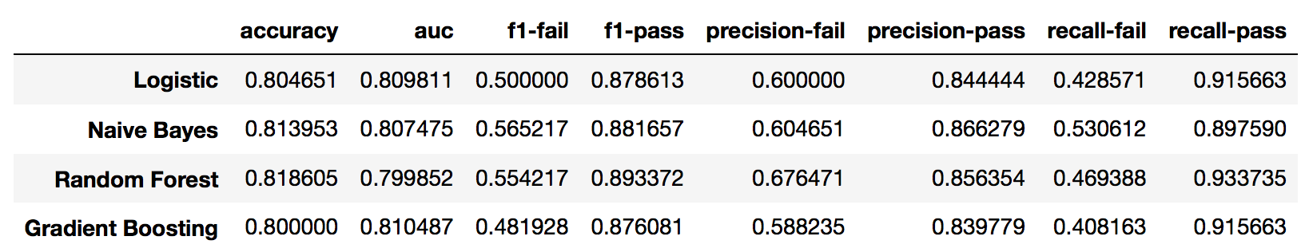
Models’ Comparison
Low recall for “fail”
Objective: Maximize recall for ‘fail’ & AUC

Slide 6
False-Positive False-Negative Trade-off
Threshold to minimize false-negatives
Type I error: high performance students classified as “fail”
Cost: increase in public expenditures
Type II error: low performance students classified as “pass”
Short-run cost: students don’t get support and fail
Long-run cost: high costs to a Nation’s economy
“Pass”
(negative)
“Fail” (positive)
New threshold = 0.3
More students will be classified as “fail”

Slide 7
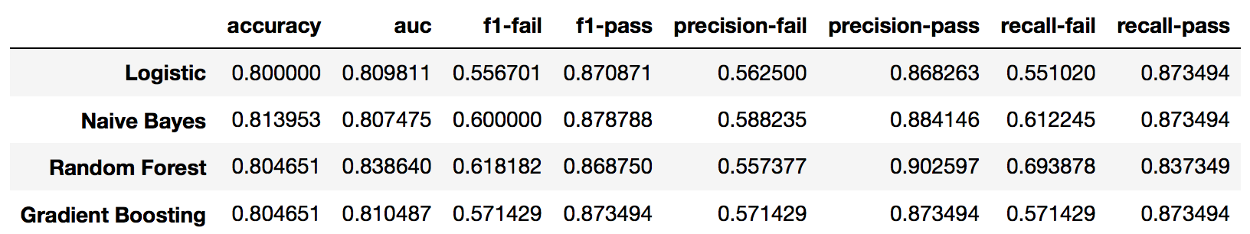
Models’ Comparison (Threshold = 0.3)
Notes:
One of them stood out

Slide 8
Models’ Comparison (Threshold = 0.3)
~70% of ”fail” students were detected
Predicted “Pass”
Predicted “Fail”
Actual “Pass”
TN = 142
FP = 24
Actual “fail”
FN = 15
TP = 34

Slide 9
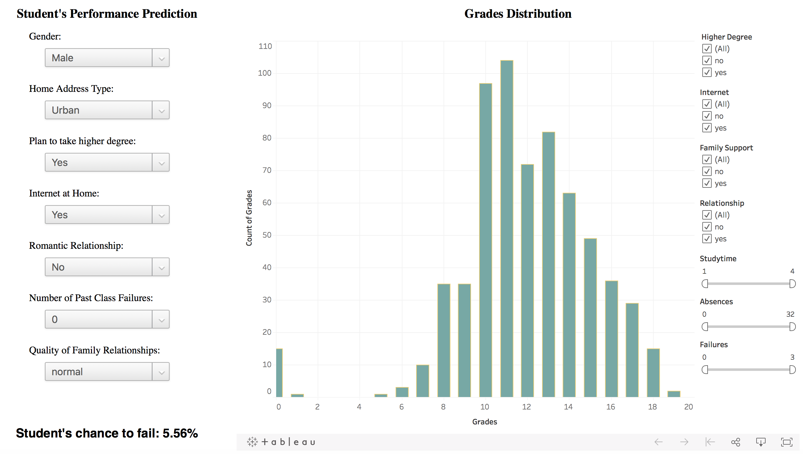
Web App (Flask + D3 + Tableau)

Slide 10
Final Thoughts
Conclusions
Random Forest performed the best
Students' performance can be predicted with a good accuracy (80%)
Need to decrease the threshold to improve the recall for “fail” students
Next Steps
Incorporate more data
Try to upsample the minority class

